Slide 1
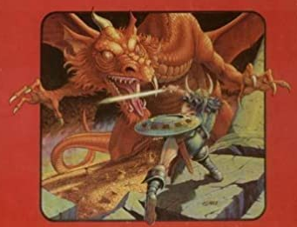
D&D 101: Intro to Dming
Notes:
Introduce yourself, have andy introduce himself
Who has experience with Dming, who has experience playing
Who’s here from critical role, it will be NOTHING like that
Why do we dm? for fun, sometimes somebody has to dm but it’s important to find your fun
You don’t actually need someone to teach you how to dm, but it can help to have more fun

Slide 2
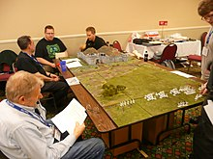
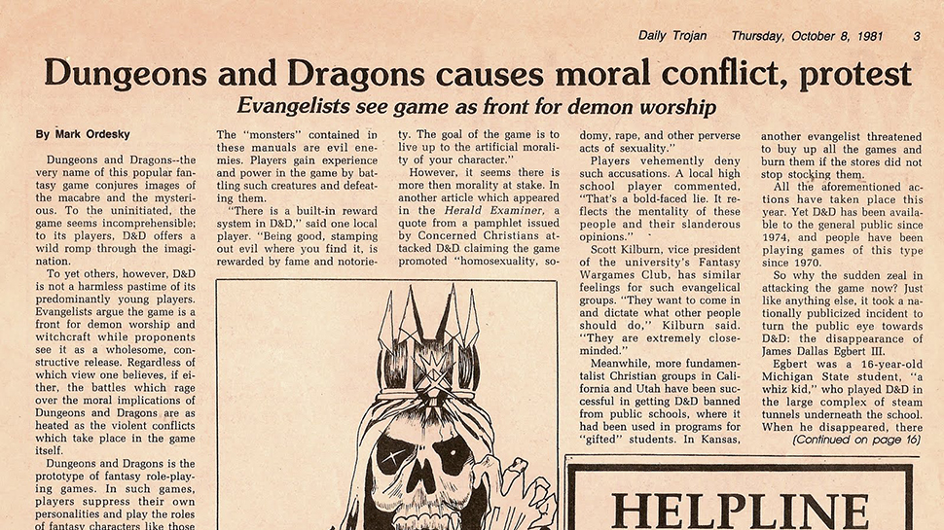
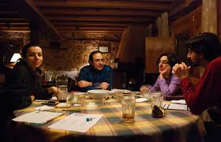
What is D&D, and what is DMing
Notes:
Why play dnd
Benefits, creativity/imagination

Slide 3
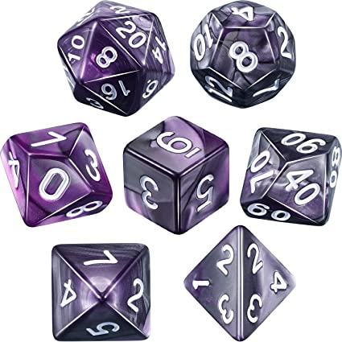
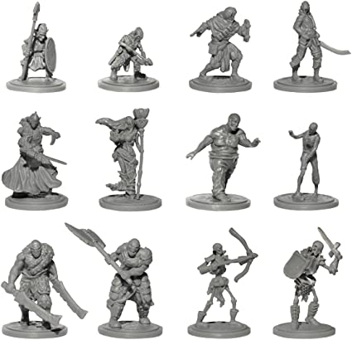
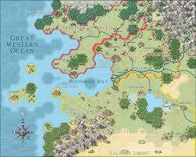
Combat and Roleplay
Notes:
Balance that works for your group
Miniatures and grids can help but theater of the mind works too
Lots of rules for overland travel and random encounters exist but they should serve the story

Slide 4
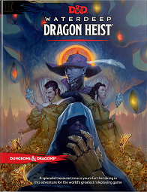
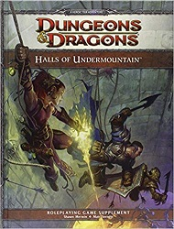
Session 0
Notes:
What do you want: story/gameplay (make sure players agree)
What do you not want: lines/veils

Slide 5
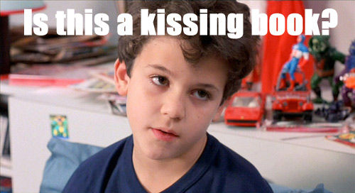
Lines and Veils
Notes:
Set the tone and what you want, make sure everyone is on the same page
Tell the COOPERATIVE story that you want to tell

Slide 6
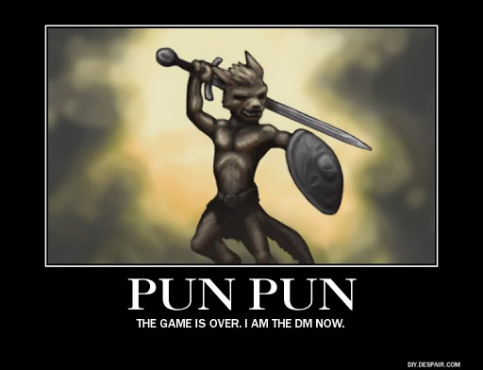
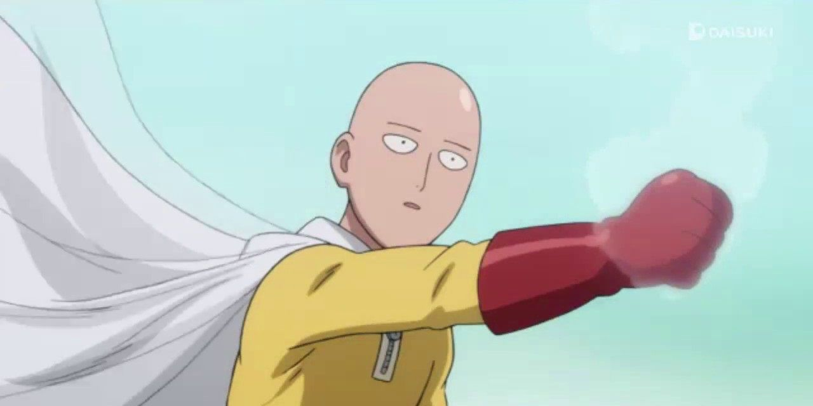
Houserules, Homebrew, and RAW
Notes:
Why rules, they are the agreed upon reality You don’t need to know all the rules
You (the DM) have final say
Rule of fun
Rule of cool
Game balance is not real

Slide 7
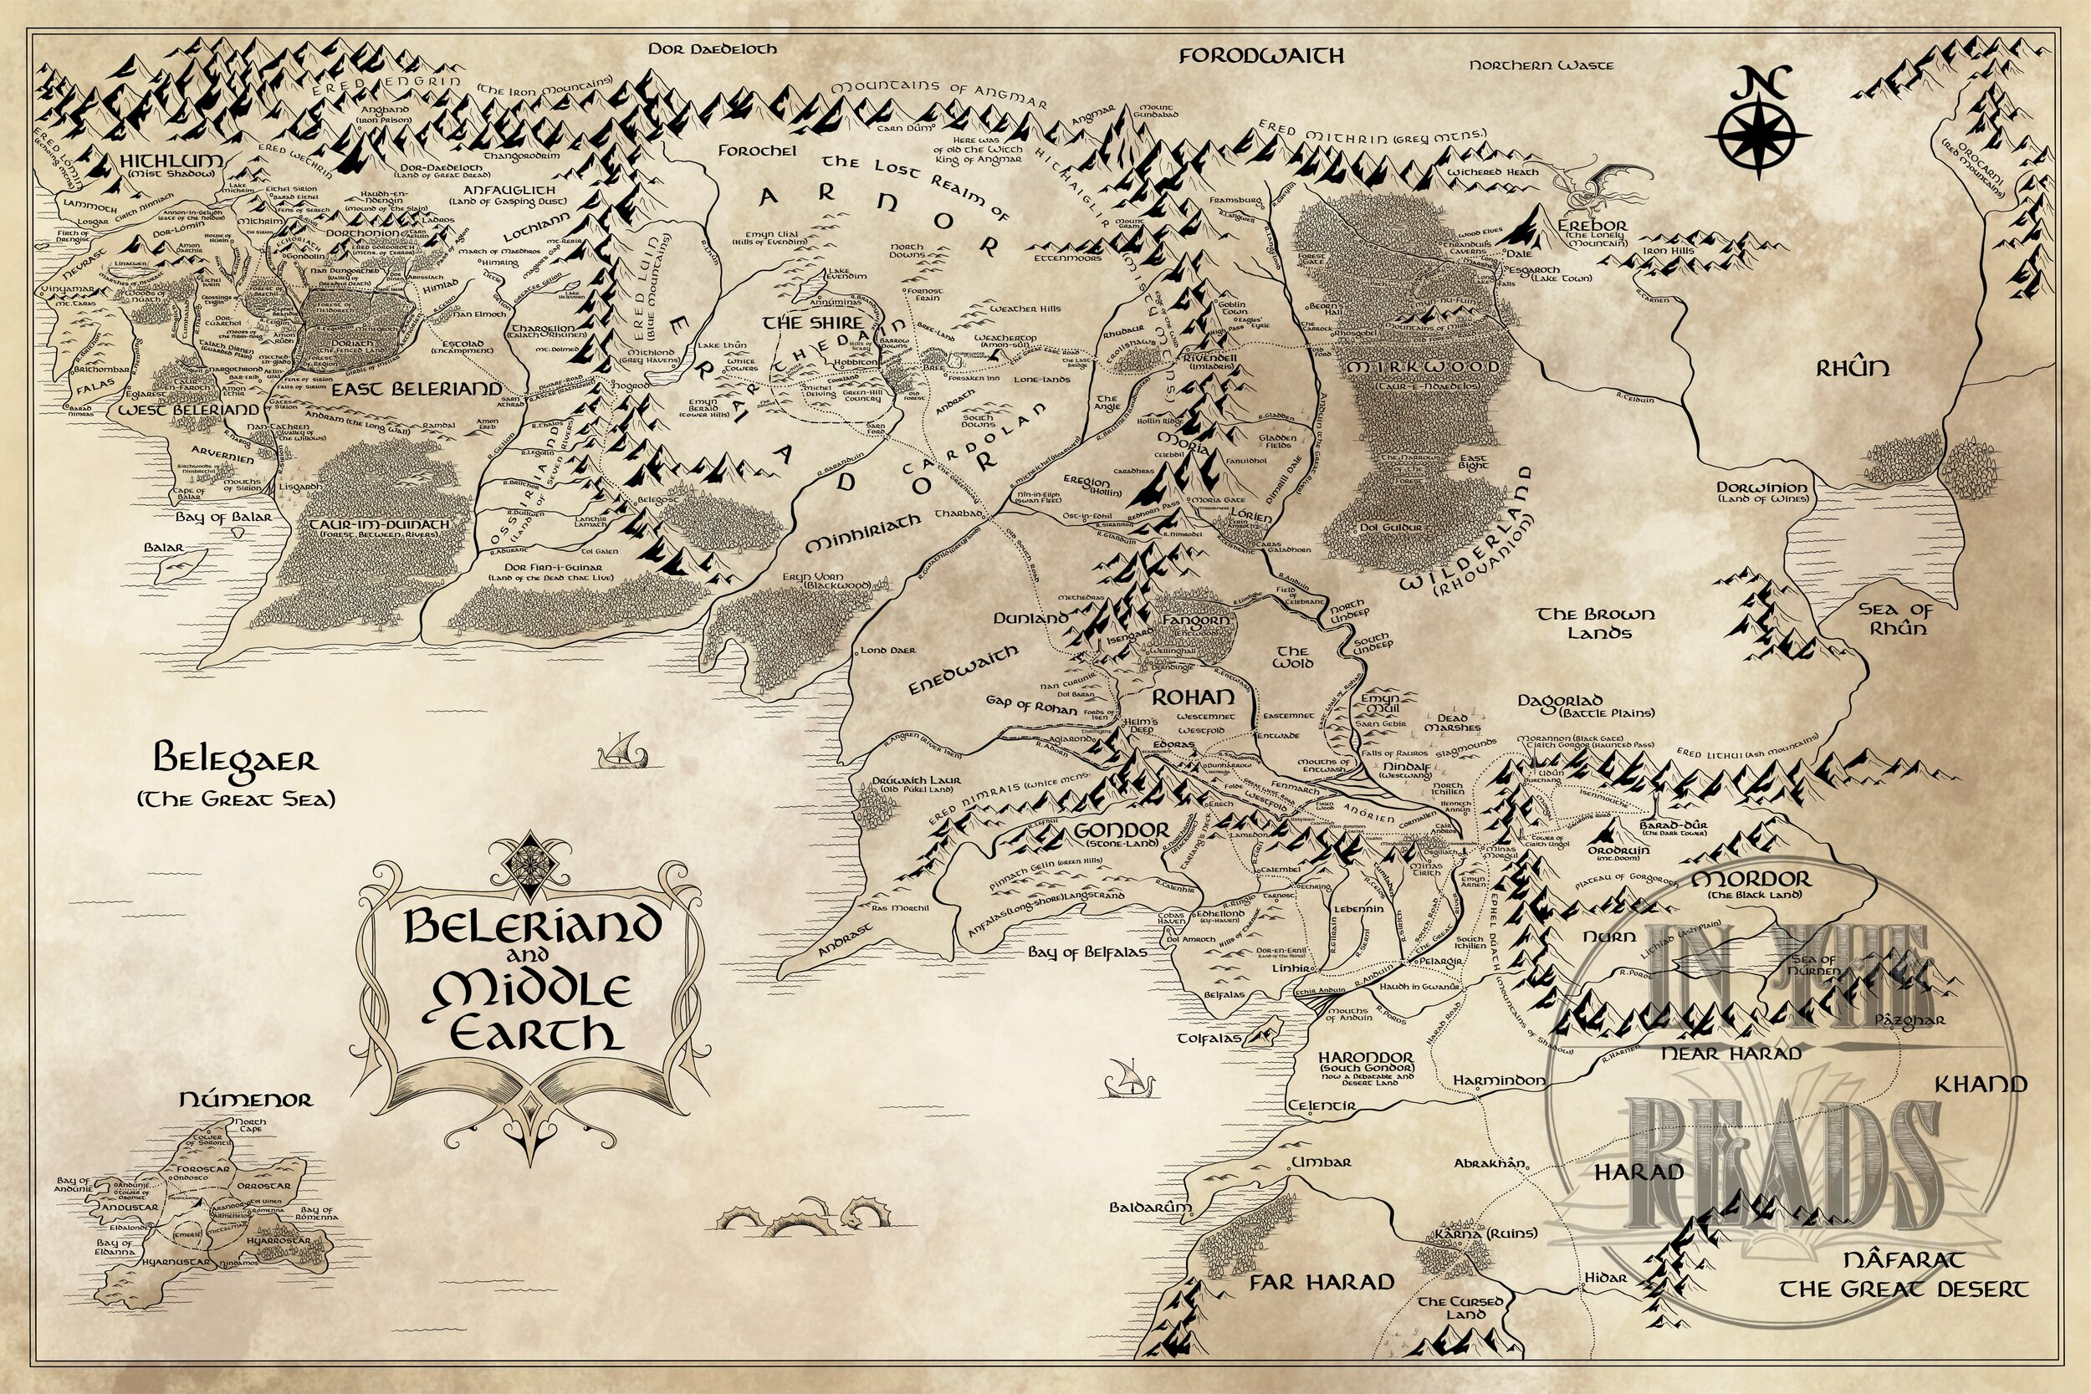
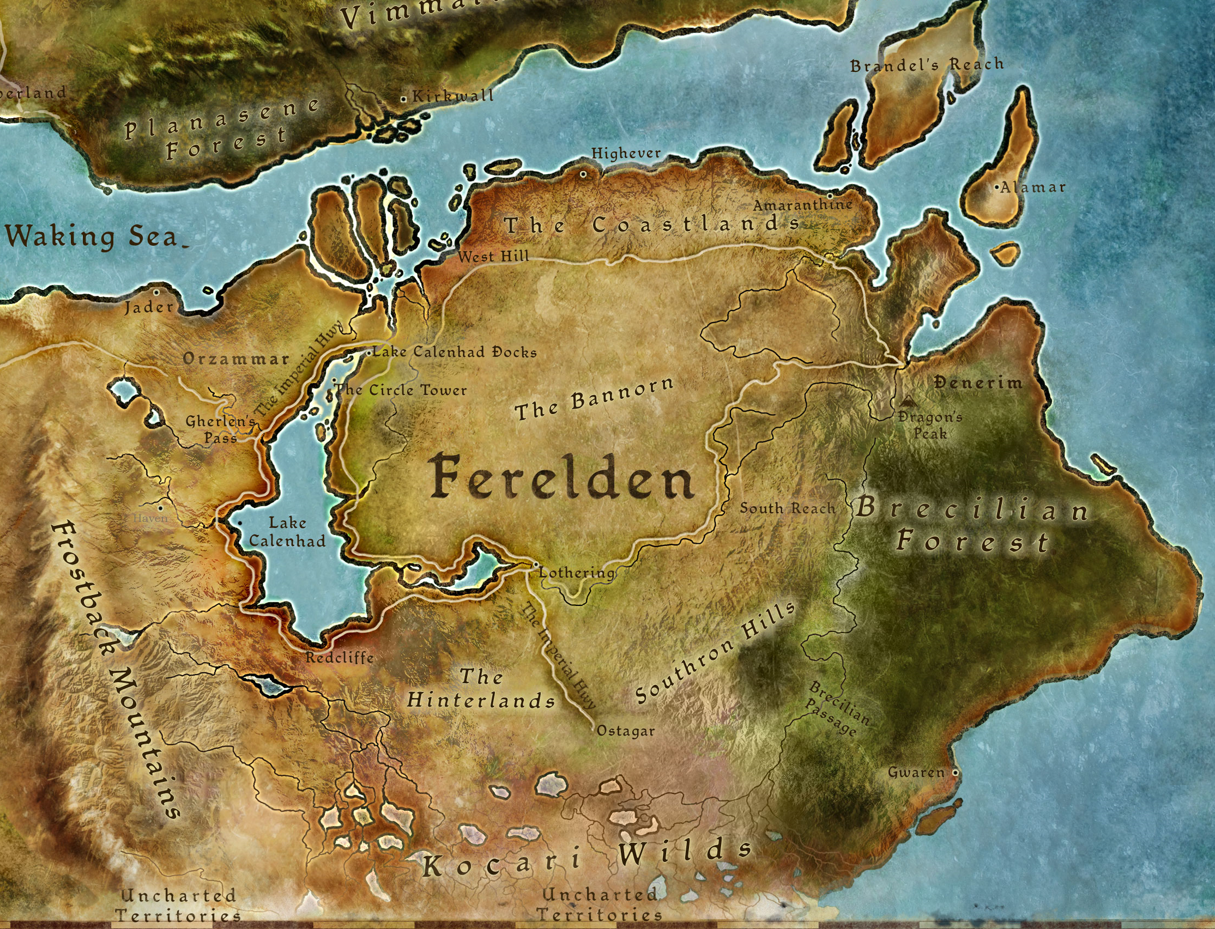
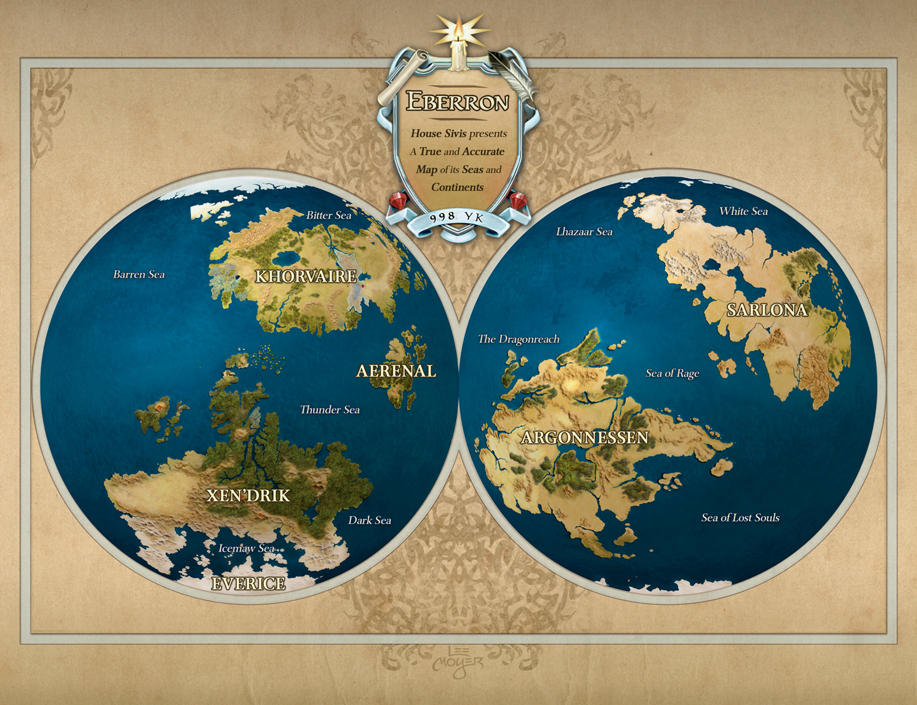
Worldbuilding
Notes:
You can use published areas, make up your own, steal from other settings
Build from the bottom up or from the top down
Make the world alive, often that means focusing on NPCs
Simple examples

Slide 8
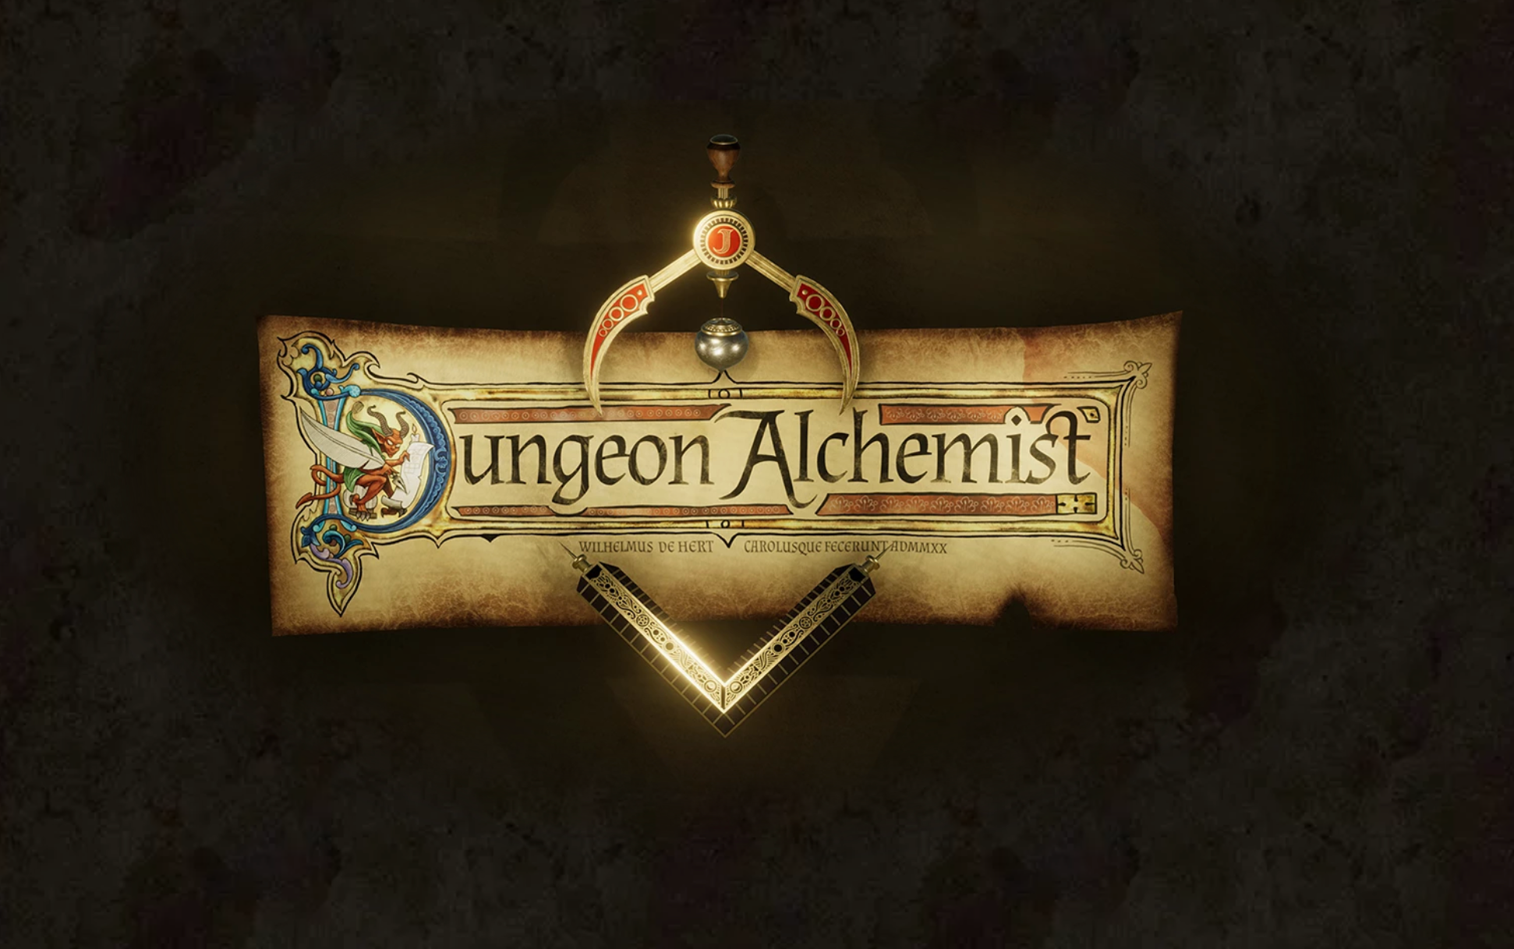
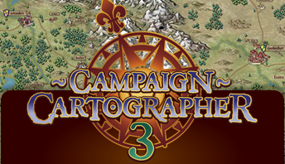
Tools Available
Notes:
Ask for tools any of them might have heard of or used

Slide 9
Additional topics
Feedback is the best way to improve
Burnout
Scheduling
Other systems
Bitd
Pbta
Fate
WoD
Ars magica
Notes:
D&D sessions vs campaigns

Slide 10
Questions?
Notes:
Introduce yourself, have andy introduce himself
Who has experience with Dming, who has experience playing
Who’s here from critical role, it will be NOTHING like that
Why do we dm? for fun, sometimes somebody has to dm but it’s important to find your fun
You don’t actually need someone to teach you how to dm, but it can help to have more fun

